Slide 1
Module 14 & 15: Power BI integration with Jupyter Notebook

Slide 2
Lesson
What is Power BI embedded analytics
Embed for your organization or customers
New playground developer experience
Power BI in Jupyter notebooks
Demo
Q & A

Slide 3
What is Power BI embedded analytics
Power BI analytics in your web application
Exceptional analytics in your app by using and branding Power BI as your own.
Personalize user experience and visuals
Deliver intelligent insights to your users and perform actions from insights.
Deliver analytics with total confidence
Keep user information secured. Use row-level security to limit the users’ access to data.
Purpose-built for developers
Client APIs, REST APIs, and tools enable developers to automate processes and minimize time to market.
Notes:
total control over visuals and features.→ Choose the best way to visualize your data and the best way to make it feel a part of your user flow.

Slide 4


Embed Power BI for your organization or customers
Requires end-user authentication to Power BI
Embed for your organization
Powered by PowerBI-Client SDK
URL embedding in website/portal
Embed in SharePoint/Teams
Embed for your customers
Powered by PowerBI-Client SDK
Notes:
And now let’s explore the most common options to deploy Power BI embedded analytics for users
Customers deploy Power BI for their users depending on their profile and needs. <CLICK>
As you can see in the frame at the top of the slide, Power BI authenticated users can consume analytics directly in Power-BI.Com SaaS application or consume Power BI embedded analytics in Websites, portals, SharePoint Web part or Teams within their organizations.
On the bottom you can see the embedding option for non-Power BI authenticated users: Embed for your customers
Embed for your customers makes use of one entity to manage all authentications to Power BI
Users authenticate to the Web application with any authentication method selected by the app owner. (as you saw in the demo)

Slide 5
Embed for your organization
(aka User owns data)
Embed for your customers
(aka App owns data)
Internal users
External users
Authentication to Azure AD
Use your own authentication
End-users require Power BI license
No end-user license
Interactive authentication flow
Non-interactive authentication flow
(Using Service Principal/Master User)
Notes:
In this session we focus mainly on the options powered by JavaScript SDK: Embed for your organization (also known as ‘User Owns Data’) AND Embed for your customers (known as App Owns Data).
<CLICK>
Embed for your organization is aimed at INTERNAL USERS, authenticated to Azure Active Directory. End-Users require a Power BI license AND the authentication flow in INTERACTIVE.
<CLICK>
Embed for your customers is mainly for External Users AND the App owners can use their own authentication (as you saw in the demo). End Users do not require a Power BI license, AND the authentication flow is NON-interactive

Slide 6



Embed Power BI in Jupyter Notebooks
Power BI Jupyter Client package

Slide 7
Embed Power BI in Jupyter Notebooks
Power BI and Jupyter Notebooks are popular tools, but you may have never thought about using them together.
Microsoft recently (May 25, 2021) announced the ability to include Power BI reports inside Jupyter notebooks. After overcoming the dazzle of this exciting feature, what comes to my mind is: “Why do we need this?”
I’m far from being a Jupyter notebook expert, but as far as I know, they are used for interactive analysis. Why, in the middle of an interactive analysis, would I need to get a Power BI Report?
Why should I move it to Jupyter and make this kind of integration with an existing report?

Slide 8
Choosing the tool
Where could I create a Jupyter notebook?
I chose to use Visual Studio Code to create the Jupyter notebook. Experts in Jupyter notebooks might use other tools, so I’m unsure if VS Code is the best tool to deal with data, but it works.
Once deciding to use Visual Studio Code, the Jupyter extension must be installed. It’s easy to find the Extensions on the left toolbar and check for Jupyter.

Slide 9
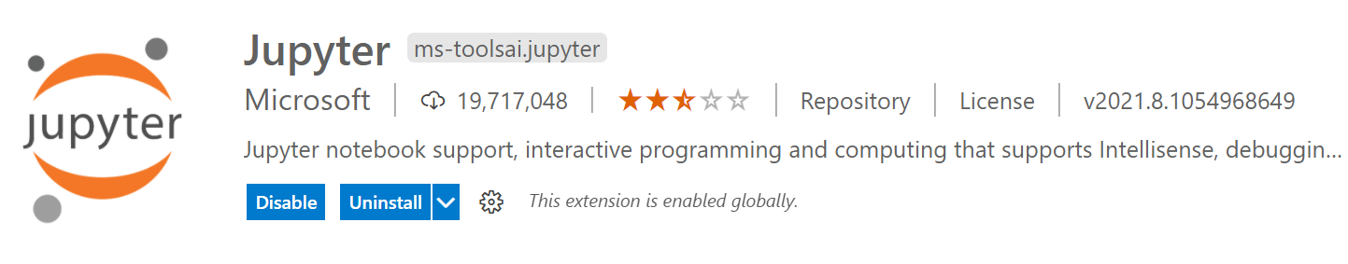
Choosing the tool
As I explained, I am not a Jupyter expert. Where could I create a Jupyter notebook?
I chose to use Visual Studio Code to create the Jupyter notebook. Experts in Jupyter notebooks might use other tools, so I am unsure if VS Code is the best tool to deal with data, but it works.
Once deciding to use Visual Studio Code, the Jupyter extension must be installed. It is easy to find the Extensions on the left toolbar and check for Jupyter.

Slide 10
Authentication options
Authentication options will require interactive actions by the user on the app, while the other two will not require any interactive action.
Interactive Flow:
This one starts an interactive authentication process opening a browser window for authentication. Once the authentication is done, the notebook receives the authentication token back from the browser window.
Device Flow:
This is the one to use for this example. It starts an interactive authentication process, but the process keeps no relation between the notebook and the browser window. In the notebook, it provides a link and a code. You need to access the link in any browser window you like, input the code, and authenticate. The website will provide the authentication token back to the notebook. Only after this process, the execution can continue.
Service Principal Flow:
This authentication method is basically an App authentication, usually used by services and applications. An App is registered in Azure AD and generates a ClientID and secret for the authentication of a client app.
Master User Flow:
In this one, you have a username and password, and you will use them for the authentication.

Slide 11
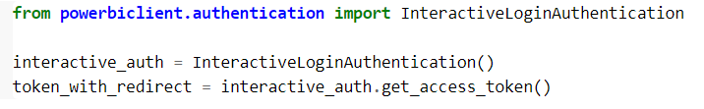
Interactive Flow
Interactive Flow:
This one starts an interactive authentication process opening a browser window for authentication. Once the authentication is done, the notebook receives the authentication token back from the browser window.
from powerbiclient.authentication import InteractiveLoginAuthentication
interactive_auth = InteractiveLoginAuthentication()
token_with_redirect = interactive_auth.get_access_token()
Note: Either use auth object created or access token acquired above while creating the report instance

Slide 12
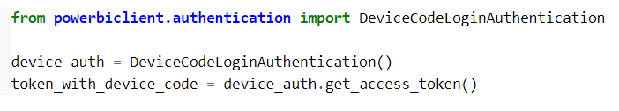
Device Flow
This is the one to use for this example. It starts an interactive authentication process, but the process keeps no relation between the notebook and the browser window. In the notebook, it provides a link and a code. You need to access the link in any browser window you like, input the code, and authenticate. The website will provide the authentication token back to the notebook. Only after this process, the execution can continue.
from powerbiclient.authentication import DeviceCodeLoginAuthentication
device_auth = DeviceCodeLoginAuthentication()
token_with_device_code = device_auth.get_access_token()

Slide 13
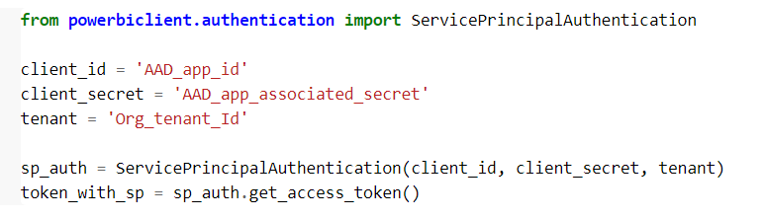
Service Principal Flow
This authentication method is basically an App authentication, usually used by services and applications. An App is registered in Azure AD and generates a ClientID and secret for the authentication of a client app.
from powerbiclient.authentication import ServicePrincipalAuthentication
client_id = 'AAD_app_id’ //5c182059-fb26-4205-9f16-d5e89e935c26
client_secret = 'AAD_app_associated_secret’ //1T0R_6_0YkD._S52hwVaP0_1U5kY-jp5VW
tenant = 'Org_tenant_Id’ //dd61caee-592d-417d-ba62-17398b79ad0f
sp_auth = ServicePrincipalAuthentication(client_id, client_secret, tenant)
token_with_sp = sp_auth.get_access_token()
Note: Use auth object created above while creating the report instance

Slide 14
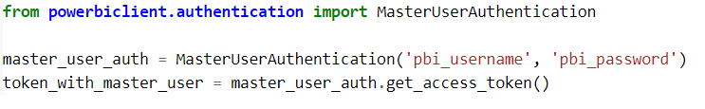
Master user flow
Master User Flow:
In this one, you have a username and password, and you will use them for the authentication.
from powerbiclient.authentication import MasterUserAuthentication
master_user_auth = MasterUserAuthentication('pbi_username', 'pbi_password')
token_with_master_user = master_user_auth.get_access_token()

Slide 15
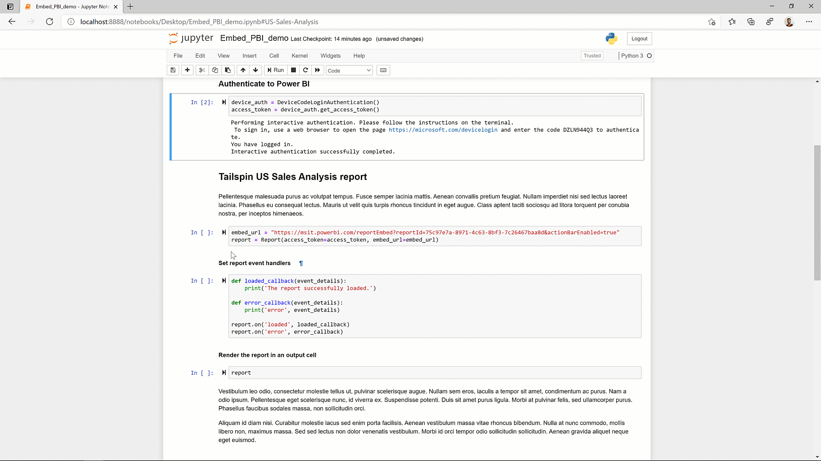
Embed Power BI in Jupyter Notebooks
Tell your data story with Power BI
Supports interactivity:
Report → Notebook (Export data)
Notebook → Report (Filter APIs)

Slide 16
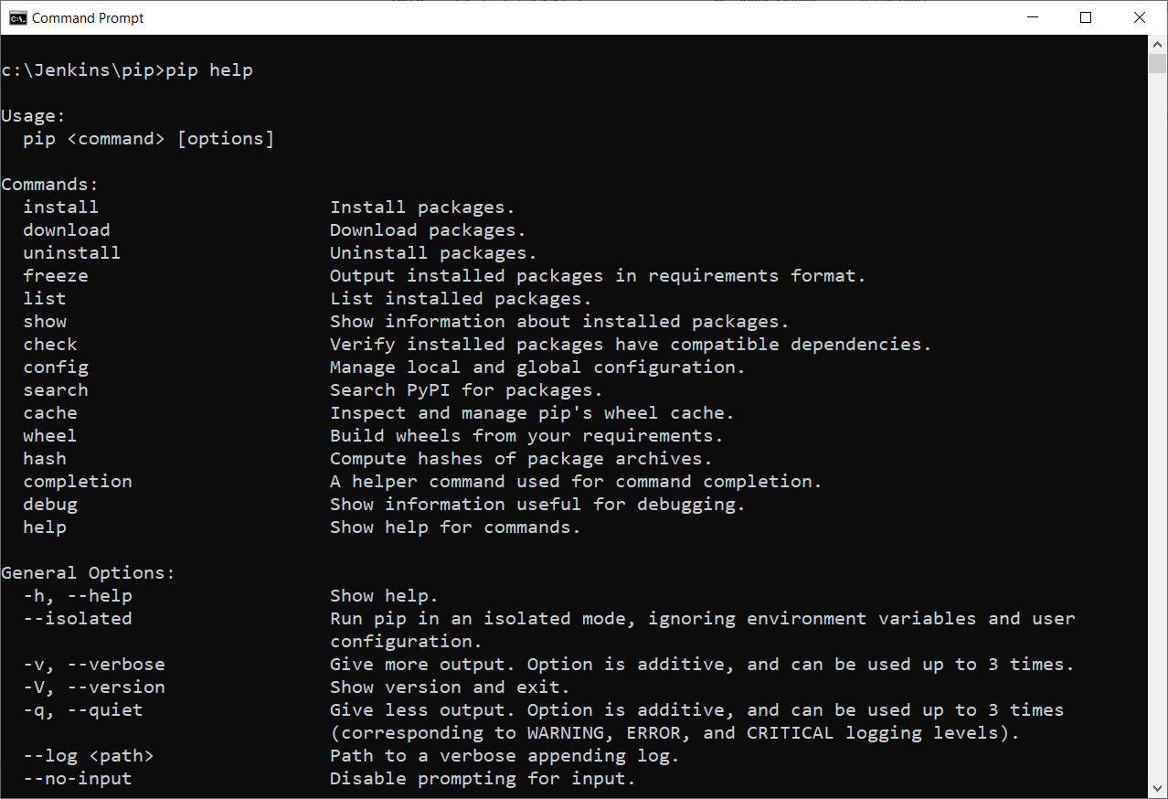
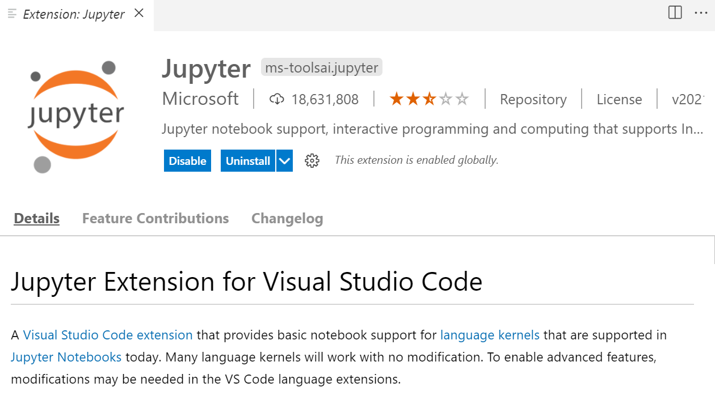
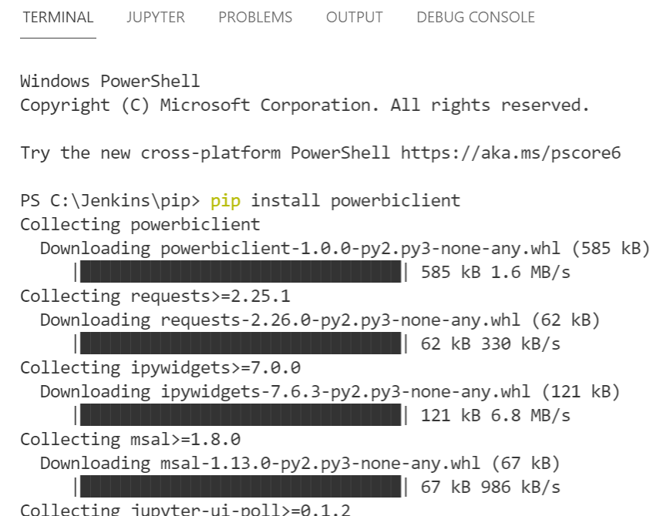
Setup the Environment
Installing PIP On Windows
Install Python latest version (3.9.6) it included PIP
Open CMD prompt and Verify pip installed pip help
Visual Studio Code
Python extension
Jupyter extension
Jupyter notebooks for PowerBI
pip install powerbiclient
pip install wheel
pip install pandas
*pandas is a software library written for the Python programming language for data manipulation and analysis.

Slide 17
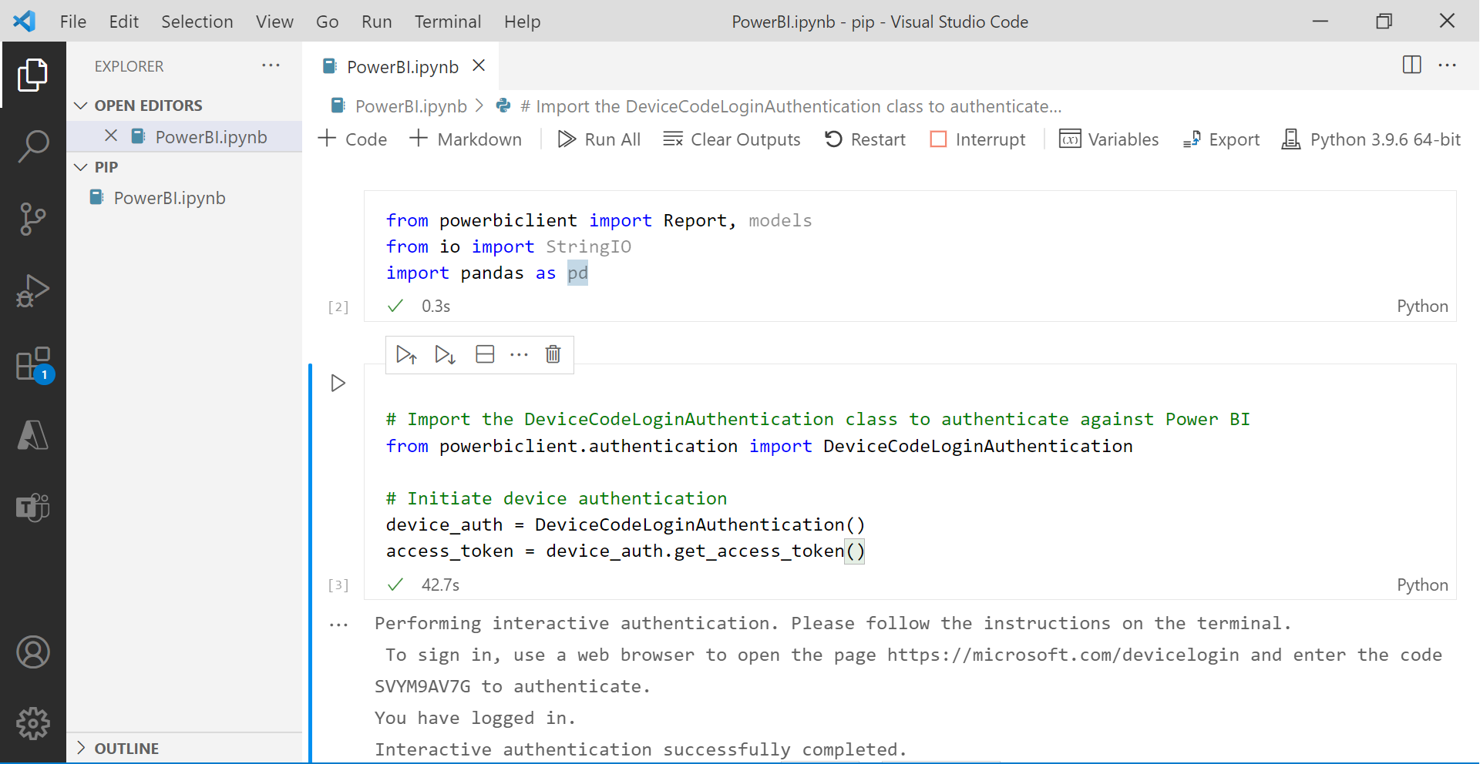

Slide 18
Demo
Get Power BI Client
from powerbiclient import Report, models
from io import StringIO
import pandas as pd
Interaction Authentication
# Import the DeviceCodeLoginAuthentication class to authenticate against Power BI
from powerbiclient.authentication import DeviceCodeLoginAuthentication
# Initiate device authentication
device_auth = DeviceCodeLoginAuthentication()
access_token = device_auth.get_access_token()

Slide 19
Demo
Get Report
group_id="70e996e2-470b-4e95-9aa6-b07fa8acf3d5"
report_id="596c85a1-1618-486b-a8e2-6b093e16f639“
report = Report(group_id=group_id, report_id=report_id, access_token = access_token)
def loaded_callback(event_details):
print('The report successfully loaded!!')
def error_callback(event_details):
print('error', event_details)
report.on('loaded', loaded_callback)
report.on('error', error_callback)

Slide 20
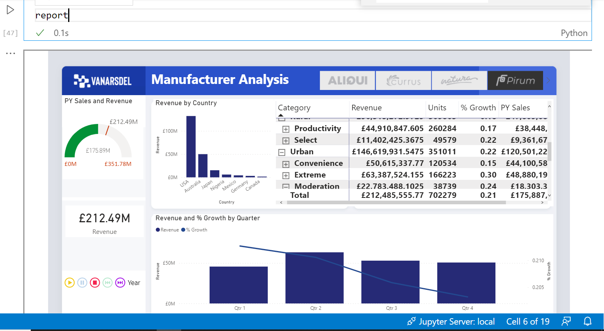
Demo

Slide 21
Demo
Get Report details
import tracemalloc
tracemalloc.start()
active_page = report.get_pages()[0]['name’]
visuals = report.visuals_on_page(active_page)
Visuals
[{'name': 'f3feab200dd10010895c', 'type': 'slicer', 'layout': {'x': 640.5194805194806, 'y': 43.24675324675325, 'z': 0, 'width': 597.2727272727273, 'height': 60.77922077922078, 'displayState': {'mode': 0}}}, {'name': 'c6012d9c7ba00c7e6bd6', 'title': 'Revenue by Country', 'type': 'columnChart', 'layout': {'x': 257.910447761194, 'y': 119.40298507462687, 'z': 1000, 'width': 294.92537313432837, 'height': 263.88059701492534, 'displayState': {'mode': 0}}}, {'name': 'bc86088011d51323506e', 'title': 'Revenue and % Growth by Quarter', 'type': 'lineClusteredColumnComboChart', 'layout': {'x': 257.910447761194, 'y': 402.3880597014925, 'z': 2000, 'width': 980.2985074626865, 'height': 259.1044776119403, 'displayState': {'mode': 0}}}, {'name': 'f9b5967bcea0167c07b2', 'type': 'card', 'layout': {'x': 41.7910447761194, 'y': 380.8955223880597, 'z': 3000, 'width': 192.23880597014926, 'height': 77.61194029850746, 'displayState': {'mode': 0}}}, {'name': 'f63b02ead35aea90d68a', 'type': 'pivotTable', 'layout': {'x': 552.8358208955224, 'y': 119.40298507462687, 'z': 4000, 'width': 685.3731343283582, 'height': 263.88059701492534, 'displayState': {'mode': 0}}}, {'name': '1f912b730a0115b2b710', 'title': 'PY Sales and Revenue', 'type': 'gauge', 'layout': {'x': 35.82089552238806, 'y': 113.43283582089552, 'z': 5000, 'width': 198.2089552238806, 'height': 202.98507462686567, 'displayState': {'mode': 0}}}, {'name': '0c98467138a540029177', 'type': 'textbox', 'layout': {'x': 247.7922077922078, 'y': 43.24675324675325, 'z': 6000, 'width': 417.2727272727273, 'height': 60.77922077922078, 'displayState': {'mode': 0}}}, {'name': 'd23bf137b61bcc201c12', 'title': 'Year', 'type': 'PBI_CV_16948668_E17D_454B_8664_2F2C470EA8C1', 'layout': {'x': 34.62686567164179, 'y': 540.8955223880597, 'z': 7000, 'width': 201.7910447761194, 'height': 57.3134328358209, 'displayState': {'mode': 0}}}, {'name': 'a96ea9f44063d174cc0e', 'type': 'image', 'layout': {'x': 34.285714285714285, 'y': 43.42857142857143, 'z': 8000, 'width': 200, 'height': 60.57142857142857, 'displayState': {'mode': 0}}}]

Slide 22
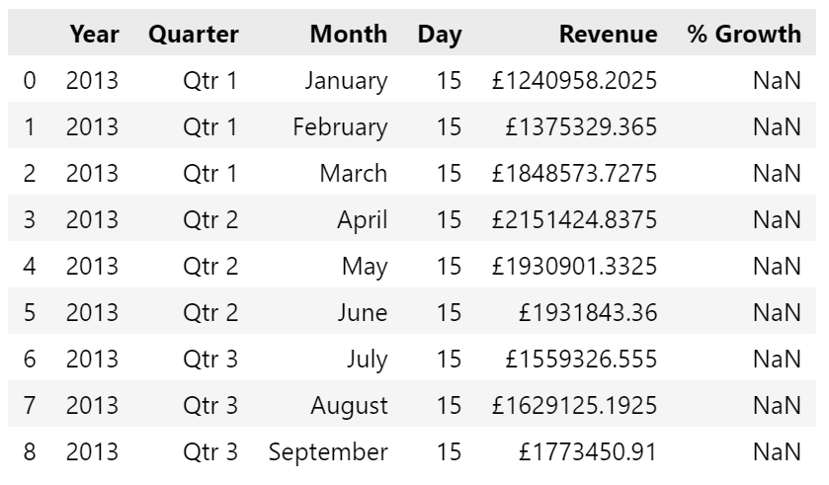
Demo
Get Particular Chart Data
visual = next(filter(lambda visuals: visuals['type'] == 'lineClusteredColumnComboChart', visuals))
visual_name = visual['name’]
visual_name
summ_data = report.export_visual_data(active_page, visual_name, rows=10)
data = StringIO(summ_data)
df = pd.read_csv(data, sep=",")
df

Slide 23
Demo
Interact with the Data
def filter_report(Year):
year_filter = {
'$schema': "http://powerbi.com/product/schema#advanced",
'target': {
'table': "Lab 1",
'column': "Year"
},
'operator': "In",
'values': [Year]
}
report.remove_filters()
report.update_filters([year_filter])
from ipywidgets import interact
interact(filter_report, Year = ['2013', '2018'])

Slide 24
Lab
https://powerbi.microsoft.com/fr-fr/blog/intro-pbi-js-api/

Slide 25
Thank you

